Slide 1
INSTGRAM FAKE ACCOUNT DETECTION
Submitted by: AMULYA C (1AM21IS009) BHUVI T G (1AM21IS018) JYOTHI U (1AM21IS045) KEERTHANA MG (1AM21IS051)

Slide 2
ABSTRACT
The project titled "Instagram Fake Account Detection" project aims to develop an innovative system that is designed to detect Instagram accounts as a fake account or a legit account. Social media plays a crucial role in our lives by creating connections, sharing information, and allowing people to find what they’re looking for, whether it’s an entertaining video or a new household product. Additionally, it provides a platform for individuals to share exciting news, pictures, and videos with family and friends, bridging distances. These days spam accounts have become a major problem in in all the social media platforms. Many users are creating fake accounts to create an illusion of having many followers to their personal accounts. Fake accounts are being created to sell fake products and services. They are also being used to impersonate other account users from common people to celebrities in order to influence, criticize, hurt feelings and reputation.

Slide 3

INTRODUCTION
Detecting fake accounts on Instagram is crucial to ensure the safety and privacy of its users. With the platform’s immense popularity, the presence of fake profiles and scammers has grown. These accounts can be used for malicious purposes, such as spreading misinformation, phishing, or identity theft. Machine learning models can help address this issue by classifying accounts as real or fake. This project aim is to build and train a deep neural network model to detect fake or spam Instagram accounts. There are few key input features which we considered to determine if the account is fake or not.

Slide 4
INTRODUCTION
The Input Features are:
• Profile Picture - The user has profile picture or not.
• Nums/Length Username - The ratio of number of numerical chars in username to its length.
• Fullname Words - Full name in word tokens
• Name/Length of Full Name - The ratio of number of numerical characters in full name to its length.
• Name = = Username - Are username and full name literally the same?
• Description Length - Bio length in characters.
• External URL - Has external URL or not.
• Private - Private or not.
• Posts - Number of posts.
• Followers - Number of followers.
• Follows - Number of follows.

Slide 5
SCOPE OF THE PROJECT
The project titled “Instagram Fake Account Detection” involves building and training a deep neural network model to identify fake or spam Instagram accounts. These days, spam accounts have become a significant issue across social media platforms. Users create fake accounts to inflate follower counts, sell counterfeit products, or impersonate others. This model is trained such that it considers the above given features and determines whether a particular account is fake or not. By resulting the output as either 0 or 1 meaning TRUSTED or FAKE respectively. Our intention is to make this software capable of thinking like a human, based on the data it is given and results in maximum probability of success.

Slide 6
SYSTEM REQUIREMENTS
Hardware Requirements
• Processor : intel i5 / i7
• RAM : 8 GB
• Hard Disk : 512 GB
Software Requirements
• OS : Windows 10/ 11
• Python 3.8 or above.
• Jupyter notebook

Slide 7
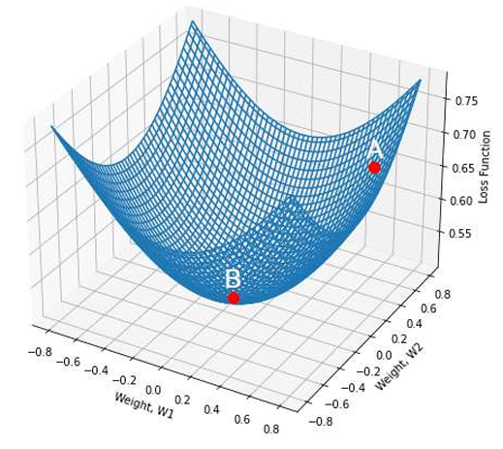
METHODOLOGY
ANN Training Process
ANN is rarely used for predictive modelling. The reason being that Artificial Neural Networks (ANN) usually tries to over-fit the relationship. ANN is generally used in cases where what has happened in past is repeated almost exactly in same way.

Slide 8
METHODOLOGY
• Gradient descent is an optimization algorithm used to obtain the optimized network weight and bias values.
• It works by iteratively trying to minimize the cost function.
• It works by calculating the gradient of the cost function and negative direction until the local or global minimum is achieved.
• If the positive of the gradient is taken, local or global maximum is achieved.

Slide 9
METHODOLOGY
Back Propagation
Back propagation is used to train ANN's by calculating gradient needed to update network weights. It is commonly used as gradient descent optimization algorithm to adjust the weight of neurons by calculating the gradient of the loss function.
PHASE 1:
• Propagation forward through the network to generate the output value(s)
• Calculation of the cost
• Propagation of output activations back through network using training pattern target in order to generate the deltas
PHASE 2:
• Weight update
• Calculating weight gradient.
• This ratio influences the speed and quality of learning also called as learning rate. The greater the ratio, the faster neuron train, but lower ratio, more accurate the training is.

Slide 10
METHODOLOGY
Confusion Matrix
A confusion matrix is a matrix that summarizes the performance of a machine learning model on a set of test data. It is a means of displaying the number of accurate and inaccurate instances based on the model’s predictions. It is often used to measure the performance of classification models, which aim to predict a categorical label for each input instance. The matrix displays the number of instances produced by the model on the test data. When assessing a classification model’s performance, a confusion matrix is essential. It offers a thorough analysis of true positive, true negative, false positive, and false negative predictions, facilitating a more profound comprehension of a model’s recall, accuracy, precision, and overall effectiveness in class distinction. When there is an uneven class distribution in a dataset, this matrix is especially helpful in evaluating a model’s performance beyond basic accuracy metrics.

Slide 11
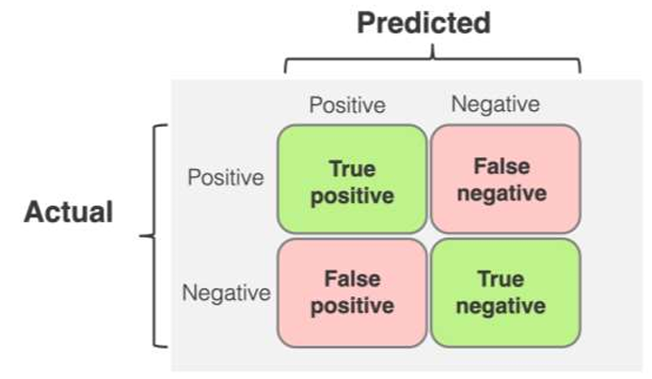
METHODOLOGY
• True Positive (TP): The model correctly predicted a positive outcome.
• True Negative (TN): The model correctly predicted a negative outcome.
• False Positive (FP): The model incorrectly predicted a positive outcome. Also known as a Type I error.
• False Negative (FN): The model incorrectly predicted a negative outcome. Also known as a Type II error.

Slide 12
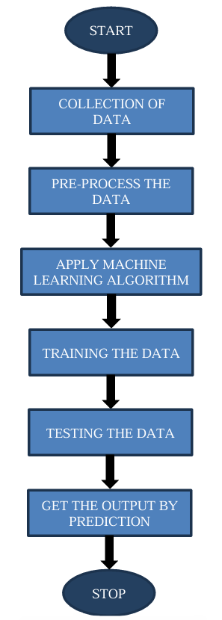
FLOWCHART

Slide 13
IMPLEMENTATION
#importing libraries
import pandas as pd
import matplotlib.pyplot as plt
import numpy as np
import seaborn as sns
import tensorflow as tf
from tensorflow import keras
from tensorflow.keras.layers import Dense, Activation, Dropout
from tensorflow.keras.optimizers import Adam
from tensorflow.keras.metrics import Accuracy
from sklearn import metrics
from sklearn.preprocessing import LabelEncoder
from sklearn.metrics import classification_report,accuracy_score,roc_curve,confusion_matrix
from jupyterthemes import jtplot
jtplot.style(theme = 'monokai', context = 'notebook', ticks = True, grid = False)

Slide 14
IMPLEMENTATION
#Loading training and testing datasets
instagram_df_test = pd.read_csv('test.csv')
instagram_df_train = pd.read_csv('train.csv')
instagram_df_train
instagram_df_test
instagram_df_train.info()
instagram_df_train.describe()
instagram_df_train.isnull().sum()
instagram_df_train['profile pic'].value_counts()
instagram_df_train['fake'].value_counts()
instagram_df_train['external URL'].value_counts()
(instagram_df_train['description length'] > 50).sum()

Slide 15
IMPLEMENTATION
instagram_df_train['external URL'].value_counts()
(instagram_df_train['description length'] > 50).sum()
instagram_df_test.info()
instagram_df_test.describe()
instagram_df_test.isnull().sum()
instagram_df_test['fake'].value_counts()
#number of fake and real accounts
sns.countplot(instagram_df_train['fake’])
#number of fake and real accounts
sns.countplot(instagram_df_train['fake'])
#private column
sns.countplot(instagram_df_train['private'],palette = "PuBu")
#Visualizing the profile pic feature
sns.countplot(instagram_df_train['profile pic'],palette = "Pastel2")

Slide 16
IMPLEMENTATION
#length of usernames(Histogram)
plt.figure(figsize = (20, 10))
sns.distplot(instagram_df_train['nums/length username'],kde=True)
#Correlation heatmap
plt.figure(figsize=(15,15))
cm = instagram_df_train.corr()
ax = plt.subplot()
sns.heatmap(cm, annot = True, ax = ax)
sns.countplot(instagram_df_test['fake'])
sns.countplot(instagram_df_test['private'],palette = "Set2")
sns.countplot(instagram_df_test['profile pic'])

Slide 17
IMPLEMENTATION
#Preparing inputs
x_train = instagram_df_train.drop(columns = ['fake'])
x_test = instagram_df_test.drop(columns = ['fake'])
x_train
x_test
#Preparing the outputs
y_train = instagram_df_train['fake']
y_test = instagram_df_test['fake']
y_train
y_test

Slide 18
IMPLEMENTATION
#Scaling the data before training
from sklearn.preprocessing import StandardScaler, MinMaxScaler
scaler_x = StandardScaler()
X_train = scaler_x.fit_transform(x_train)
X_test = scaler_x.transform(x_test)
Y_train = tf.keras.utils.to_categorical(y_train, num_classes=2)
Y_test = tf.keras.utils.to_categorical(y_test, num_classes=2)
X_train.shape,X_test.shape
Y_train.shape,Y_test.shape
#Percentage of Traininf data
Training_data_percentage = len(X_train)/(len(X_train) + len(X_test) ) * 100
Training_data_percentage
Testing_data_percentage = len(X_test)/(len(X_train) + len(X_test) ) * 100
Testing_data_percentage

Slide 19
IMPLEMENTATION
#Main model
import tensorflow.keras
from tensorflow.keras.models import Sequential
from tensorflow.keras.layers import Dense, Dropout
model = Sequential()
model.add(Dense(50,input_dim = 11, activation = "relu")) #Initial Layer
model.add(Dropout(0.3))
model.add(Dense(150, activation = "relu"))
model.add(Dropout(0.3))
model.add(Dense(25, activation = "relu"))
model.add(Dropout(0.3))
model.add(Dense(2, activation = "softmax")) #output layer
model.summary()

Slide 20
IMPLEMENTATION
model.compile(optimizer = 'adam', loss = 'categorical_crossentropy', metrics = ['accuracy'])
epochs_hist = model.fit(X_train, Y_train, epochs = 20, verbose = 1, validation_split = 0.1)
print(epochs_hist.history.keys())
plt.plot(epochs_hist.history['loss'])
plt.plot(epochs_hist.history['val_loss'])
plt.title('Model Loss Progressioin During Training/Validation')
plt.xlabel('Epoch Number')
plt.ylabel('Training and Validation Losses')
plt.legend(['Training Loss','Valdiation Loss'])
predicted = model.predict(X_test)
predicted_value = []
test = []

Slide 21
IMPLEMENTATION
for i in predicted:
predicted_value.append(np.argmax(i))
for i in Y_test:
test.append(np.argmax(i))
print(classification_report(test, predicted_value))
plt.figure(figsize=(10, 10))
con_matrix = confusion_matrix(test,predicted_value)
sns.heatmap(con_matrix, annot=True)

Slide 22
RESULTS
The Instagram Fake Account Detection developed for this project has shown promising results by achieving 95 percent accuracy in detecting the fake accounts by training the model using datasets. We have checked whether the model has reached the ability to detect an account is fake or not by inputting different set of data values which consisted 120 account details. The model predicted true values for 106 accounts and predicted false values for 14 accounts out of 120 accounts.
Overall, the Instagram Fake Account Detection project represents a significant step forward in leveraging machine learning techniques to identify fake accounts and provide more privacy. While there are still challenges to overcome, the potential benefits in terms of efficiency, accuracy, and privacy makes this an area ripe for continued research and development.

Slide 23
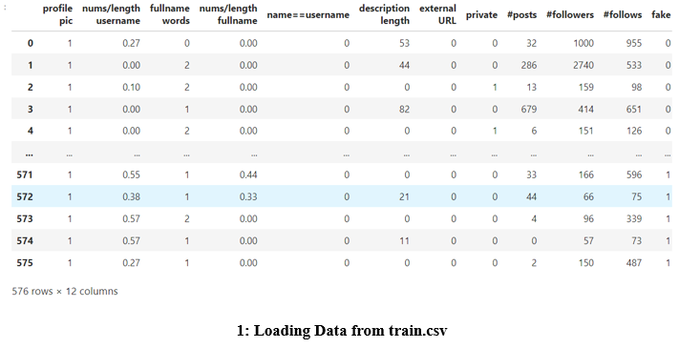
SCREENSHOT

Slide 24
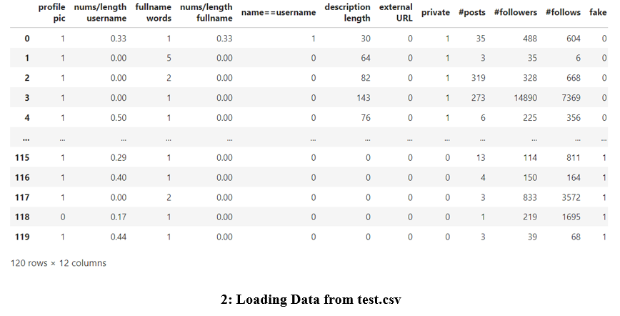
SCREENSHOT

Slide 25
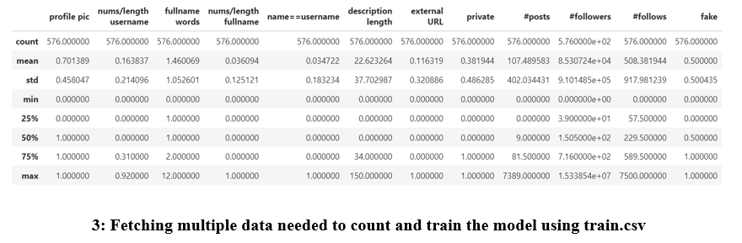
SCREENSHOT

Slide 26
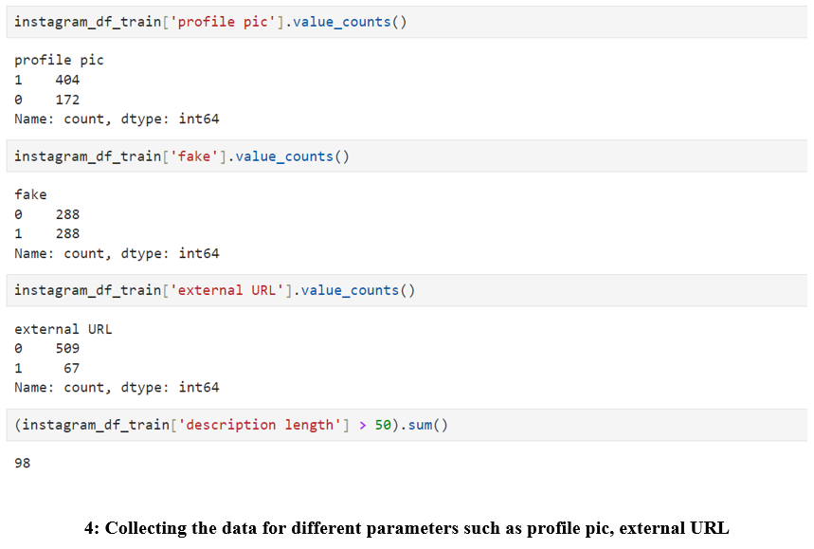
SCREENSHOT

Slide 27
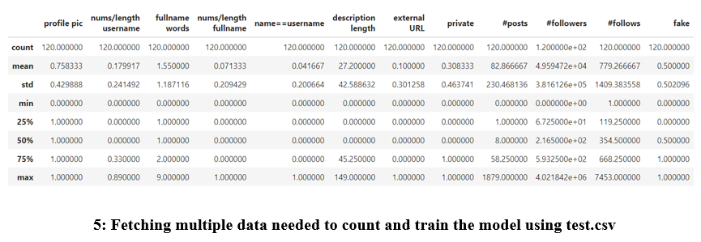
SCREENSHOT

Slide 28
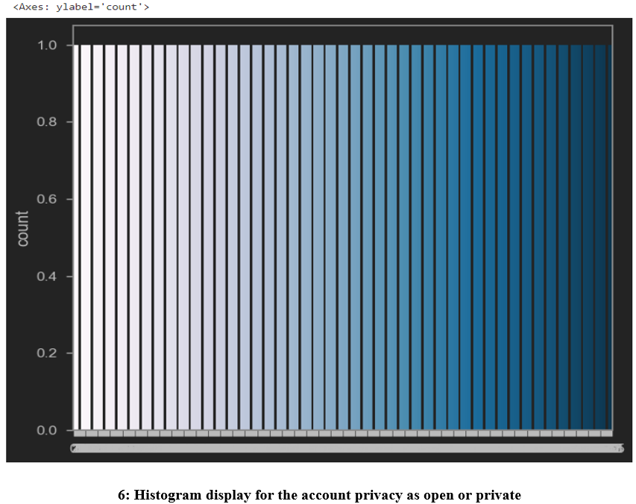
SCREENSHOT

Slide 29
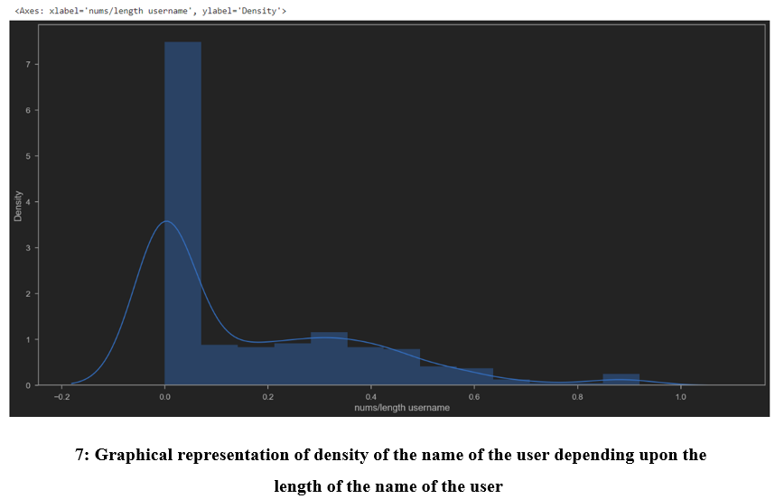
SCREENSHOT

Slide 30
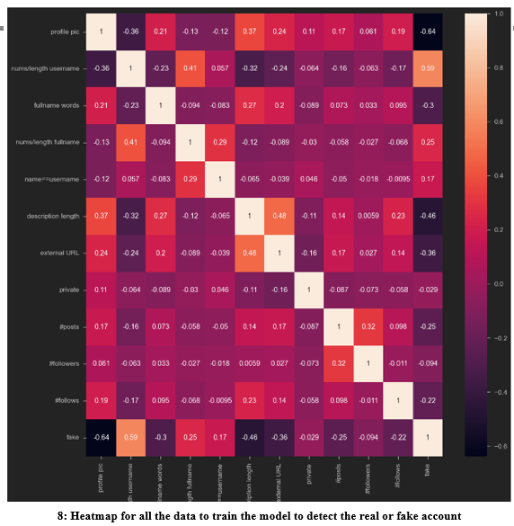
SCREENSHOT

Slide 31
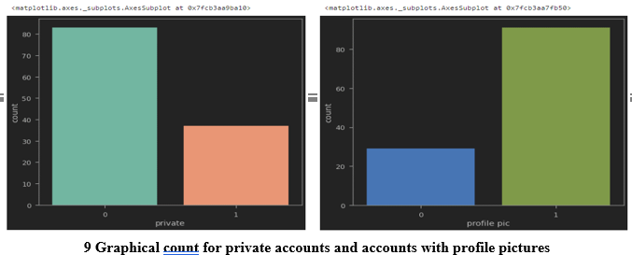
SCREENSHOT

Slide 32
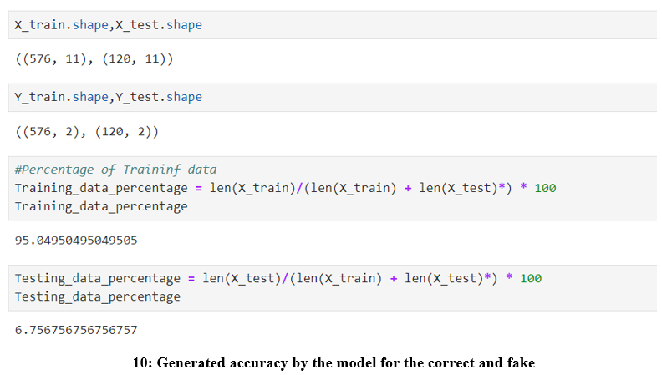
SCREENSHOT

Slide 33
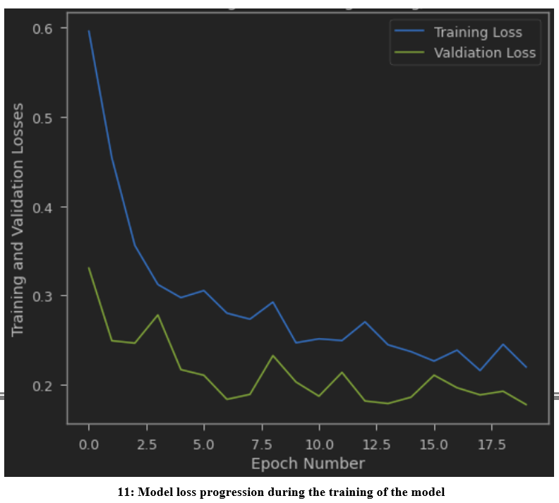
SCREENSHOT

Slide 34
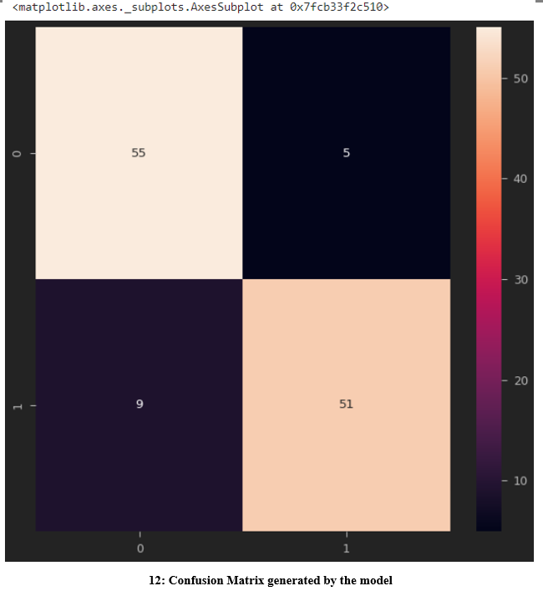
SCREENSHOT

Slide 35
CONCLUSION
We have analyzed the dataset and obtained a fairly accurate predictive model using Neural networks. The model is hence trained to detect fake accounts in Instagram based on the considered features. We achieved 95 percent accuracy in detecting the fake accounts by training the model using datasets (from train.csv). We have checked whether the model has reached the ability to detect an account is fake or not by inputting different set of data values (test.csv file) which consisted 120 account details. The model predicted true values for 106 accounts and predicted false values for 14 accounts out of 120 accounts.

Slide 36
REFERENCES
1. Pandas user guide: https://pandas.pydata.org/docs/user_guide/index.html
2. Matplotlib user guide: https://matplotlib.org/3.3.1/users/index.html
3. Seaborn user guide & tutorial: https://seaborn.pydata.org/tutorial.html
4. Tensorflow user guide : https://www.tensorflow.org/guide
5. Tenorflow Playground : https://playground.tensorflow.org
6. Neural Networks: https://towardsdatascience.com/the-mostly-complete-chart-of-neural networks-explained-3fb6f2367464

Slide 37
Thank You

